Slide 1

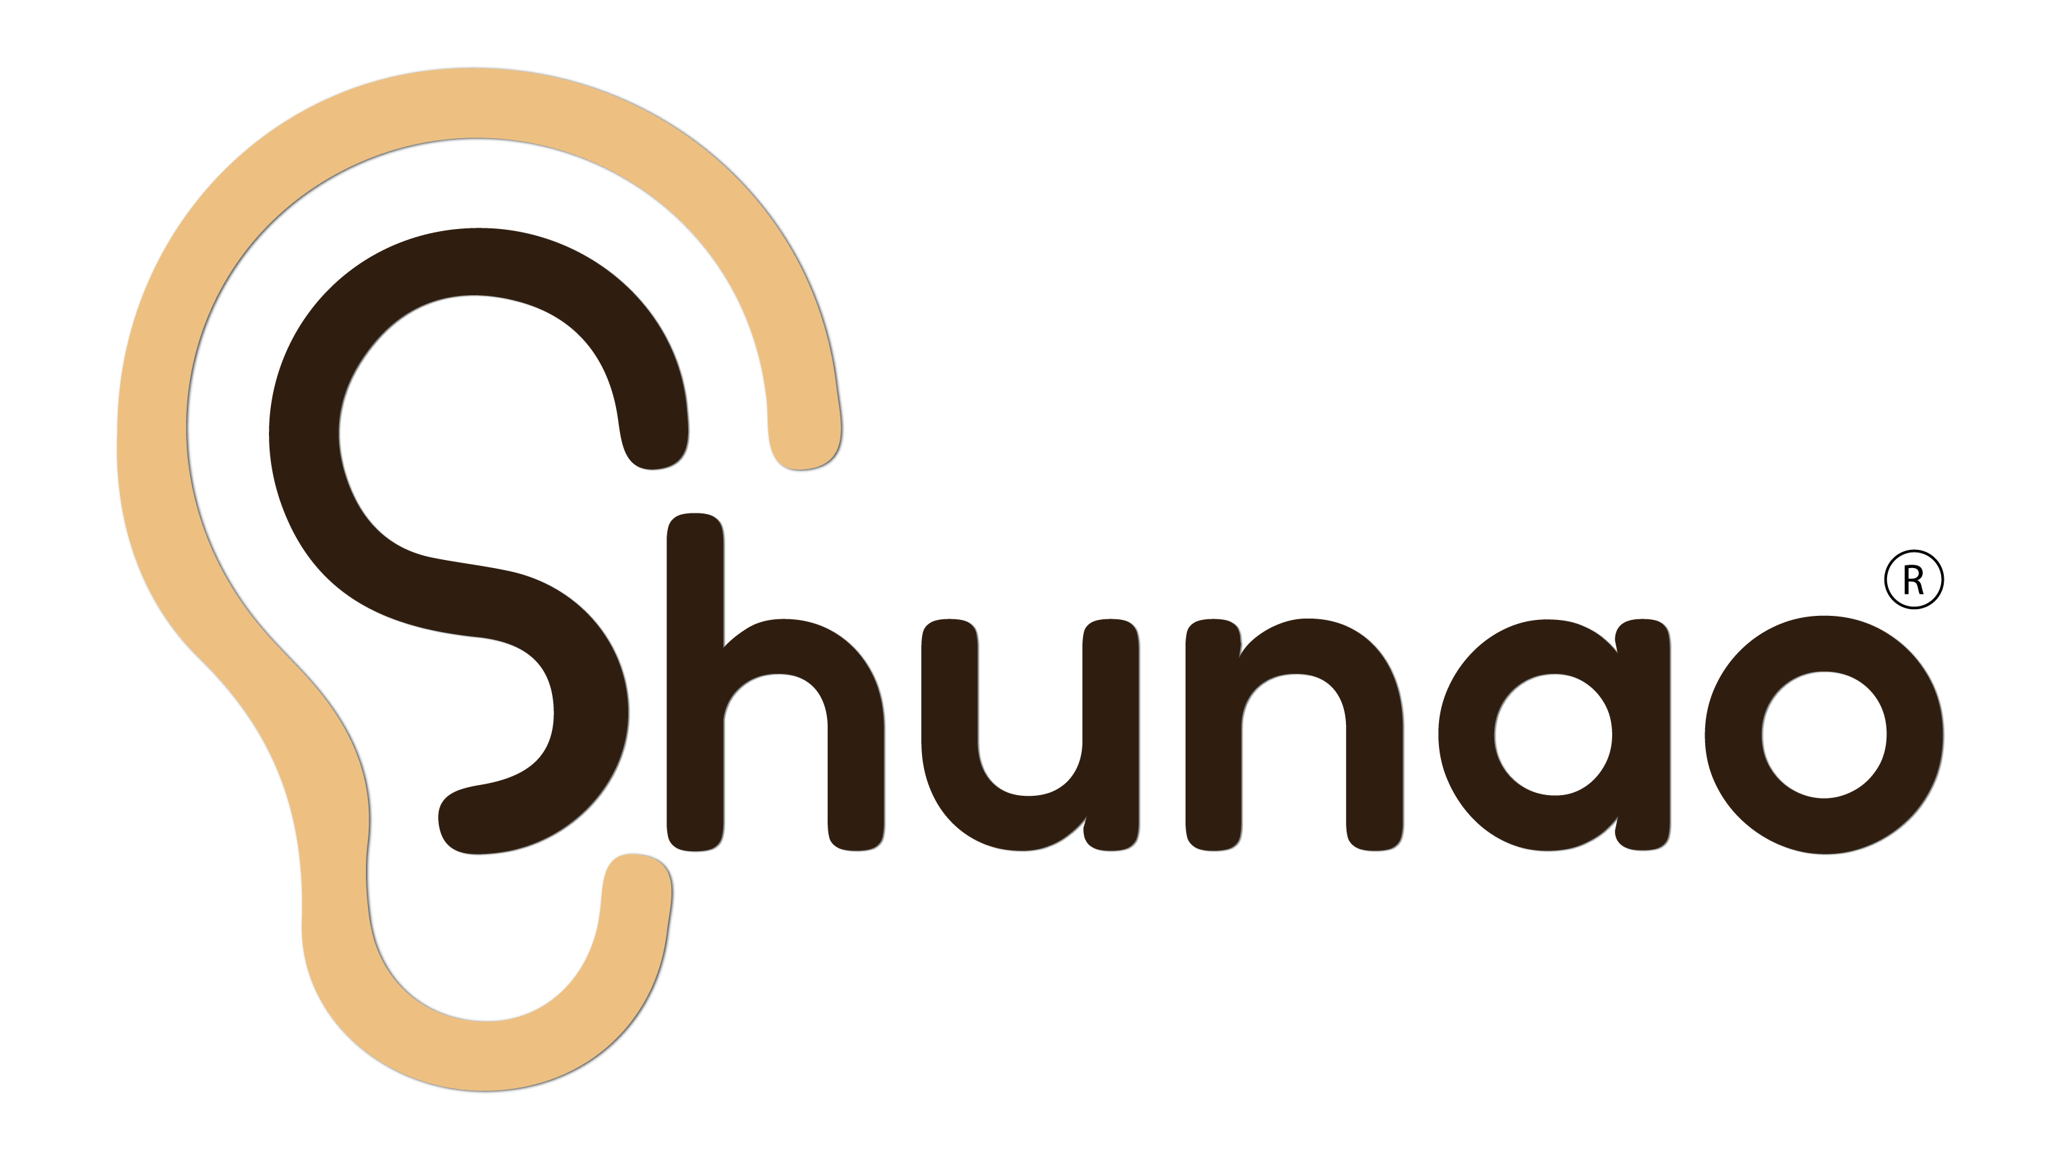
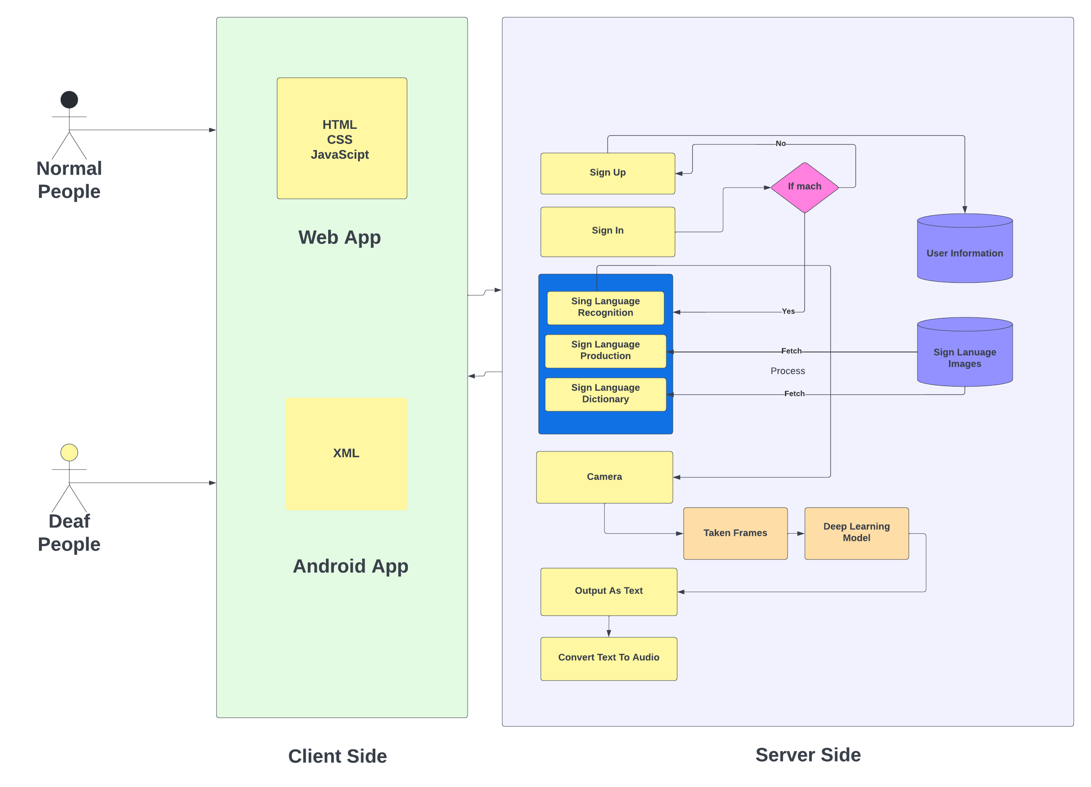
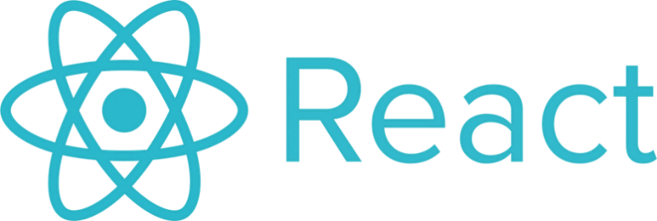

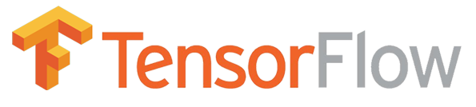

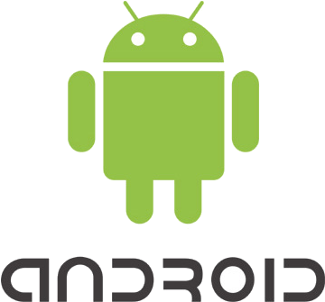

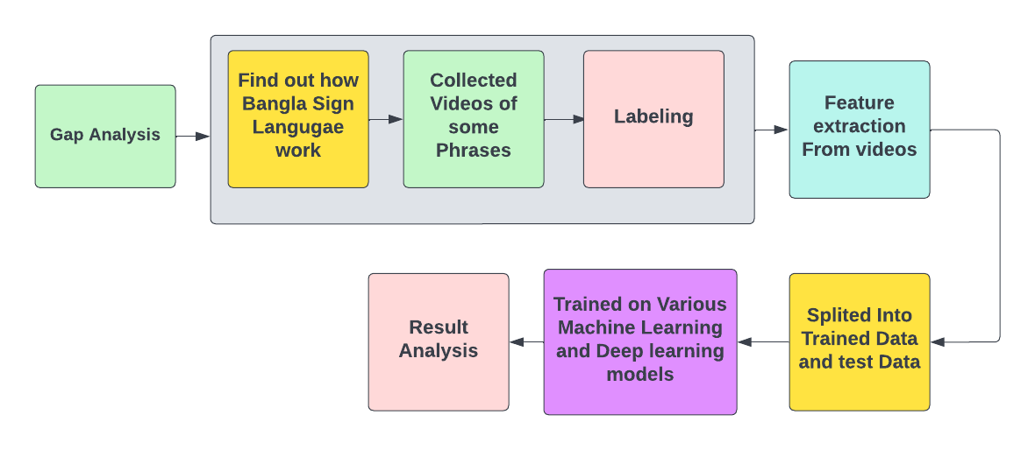
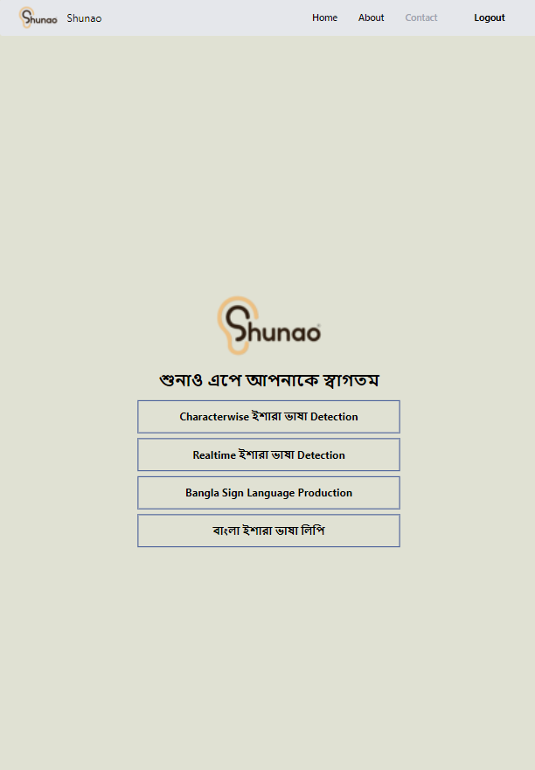
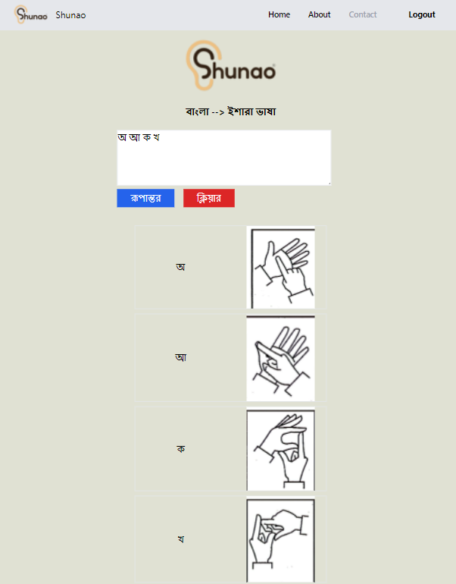
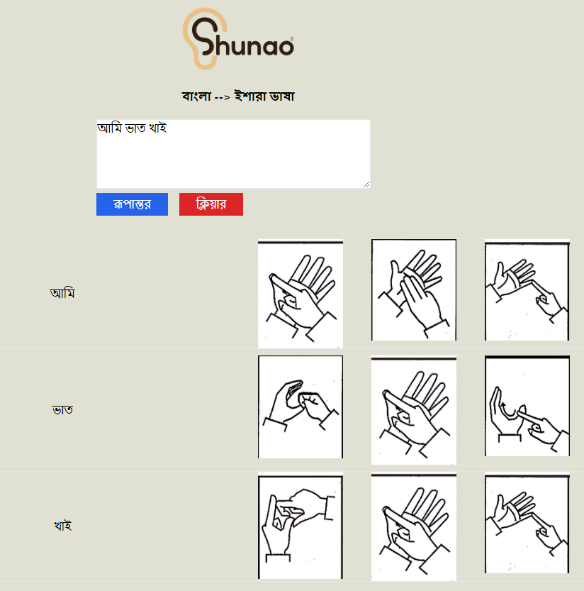
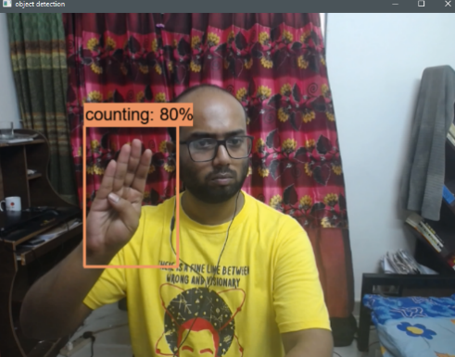
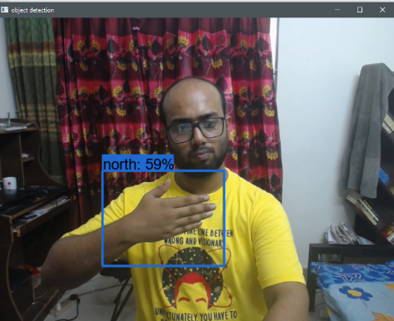
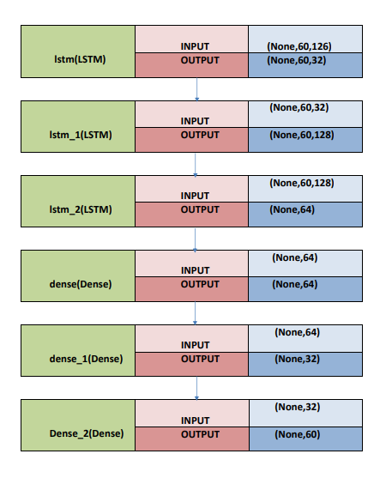
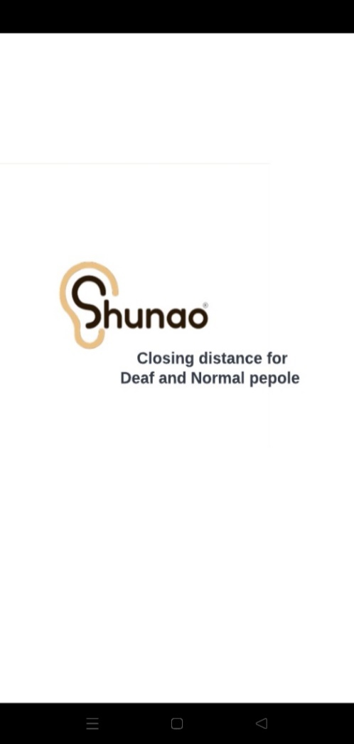
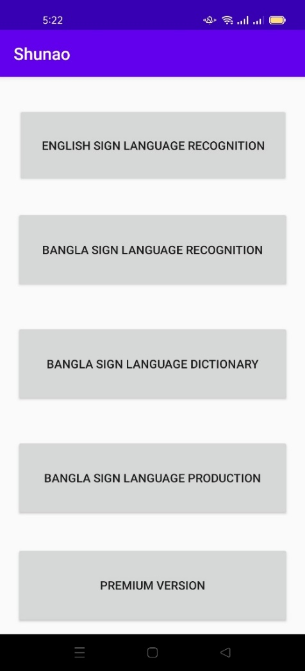
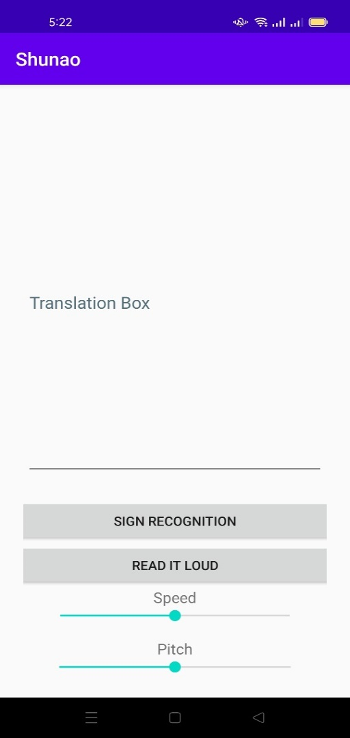
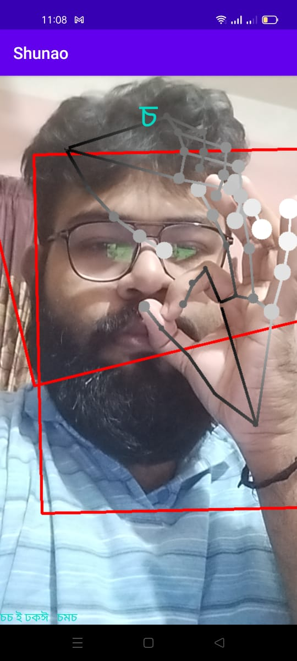
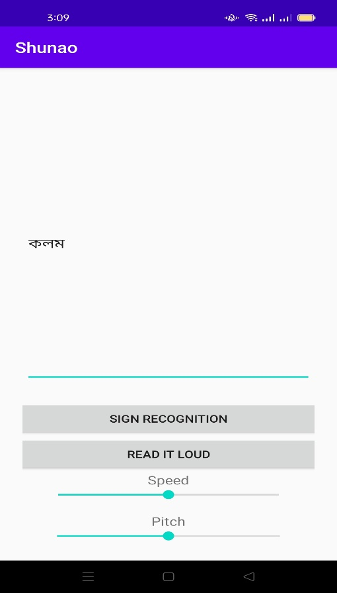
“Shunao”_ A Solution for Closing Communication Gap between Deaf and Normal people
Mohd. Istiaq Hossain Junaid, Faisal Hossain, Udyan Saha Upal, Abul Kashim
Supervisor : Dr. Rashedur M Rahman
Overview
Architecture of Shunao
Technologies Used
Shunao is a multimodal solution system developed for web-based and android based systems to provide deaf people ease of communication with the world. Our study explored the horizon of sign language recognition and production using machine learning methods and advanced product solutions with essential features to decrease the communication gap in the deaf community. Our features include real-time sign language detection and Bangla sign language generation with a dictionary-based alphabetic sign visualization.
Problem Statement
Infrastructure of Model Building
Millions of people worldwide suffer from debilitating hearing loss. The vast majority live in low- and middle-income countries, where right ear and hearing care are frequently unavailable. In a global environment, providing healthcare to all of these people is completely implausible. That is why a technological solution to this problem is obvious. Because technological advancement is the only system that can spread globally without much cost or human resources, we aspired to solve and create a solution that helps and enriches sign language researchers—as well as making mainstream products that will help the deaf community engage and connect with the outside world to have a greater impact on society and the environment. Alleviating the communication gap in the deaf community is the sole purpose and motivation for our research and developed solutions
User Interface of Web App
Best Model
Project Goals
Researching works and products on Bangla sign language recognition and production to understand in inadequacy
Building a real-time Sign Language Recognition model which is on Action Recognition based
Constructing machine learning model for recognition of Bangla Sign Language which is focused on phrases. This phrases is used in our daily life.
Building our own custom Sign Language datasets which is focused on Bangla phrases.
Training and testing our dataset for scalable and deployable recognition model
Sign language production for general people to learn and use our word generator to generate signs accordingly
Detection of a real-time sign with the help of a web camera on web-based devices or a camera on android devices
Characterize sign language Translation
(a)Home page
(b) Character wise ইশারাভাষা Detection
(c)Bangla Sign Language Production
(d) Real time Bengali sign language detection
User Interface of Android App
Fine Tuned LSTM model
Conclusion
Our primary goal in developing this system was to create a fully functional system that could cater to the deaf community masses. It would grow into a massive commercial entity. Introducing the Shunao system to the deaf community will help them communicate more effectively and close the communication gap between us. Our priority was not only to complete the project on time but also to design this system to be truly useful in the real world. We have no qualms in stating that we have exceeded our expectations in achieving what we have.
(a)Starting App
(b)Home page
(c) Sign Recognition
(d)Detecting Sign
(e)Output in Translation Box
Notes:
Behavioral results: make bar graphs of RT?
fMRI results: labels, figure caption, make blues in graph the same color
References: add marcel 2004, add numbers, rearrange

